Slide 1
Data
Sam & Stefan
January 22, 2016

Slide 2
Newspaper Data
Scans come from Newspapers.com
1783 – 2011
Pittsburgh
Cincinnati
Detroit

Slide 3
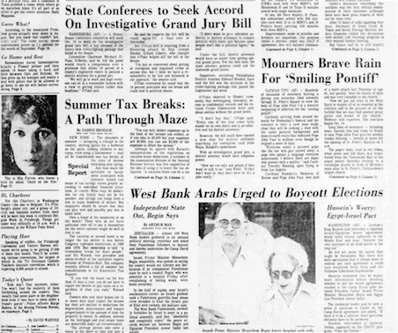
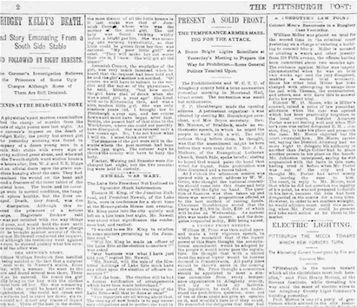
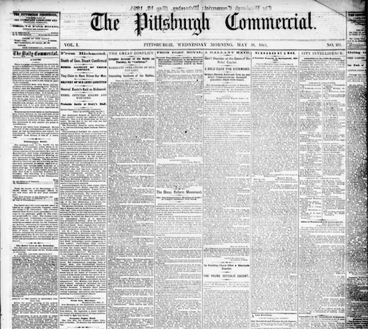
Space of Images
Image Quality
Simplicity of Layout

Slide 4
Space of Images
Image Quality
Images of low quality
and complex layout
are rare.
Simplicity of Layout

Slide 5
Space of Images
Image Quality
Simplicity of Layout

Slide 6
Space of Images
Image Quality
New Papers
Old Papers
Simplicity of Layout

Slide 7
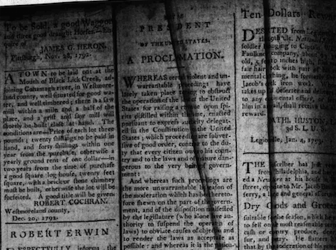
Low Quality, Simple Layout
(1783) shadow, creases, curvature

Slide 8
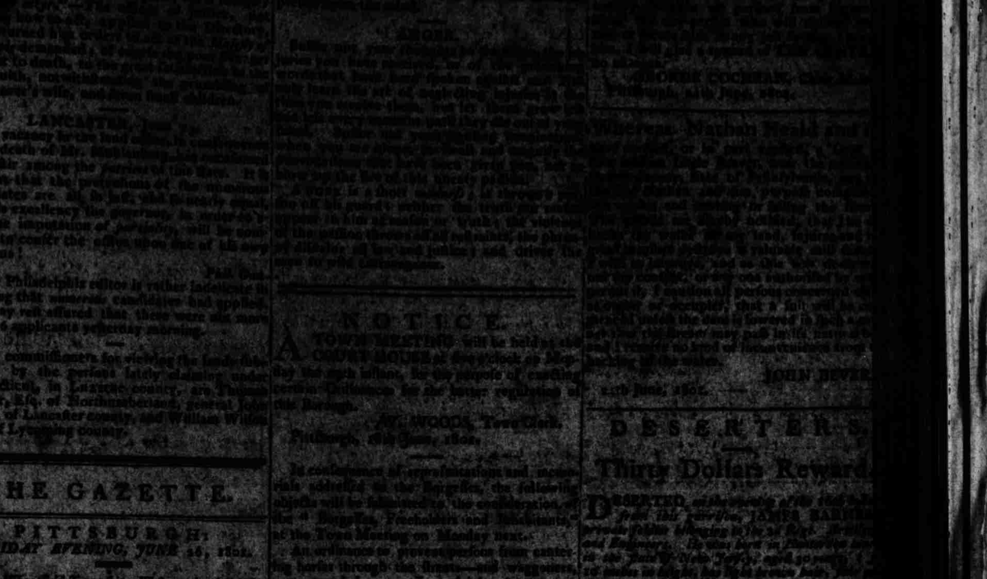
Low Quality, Simple Layout
(1802) lighting, noise

Slide 9
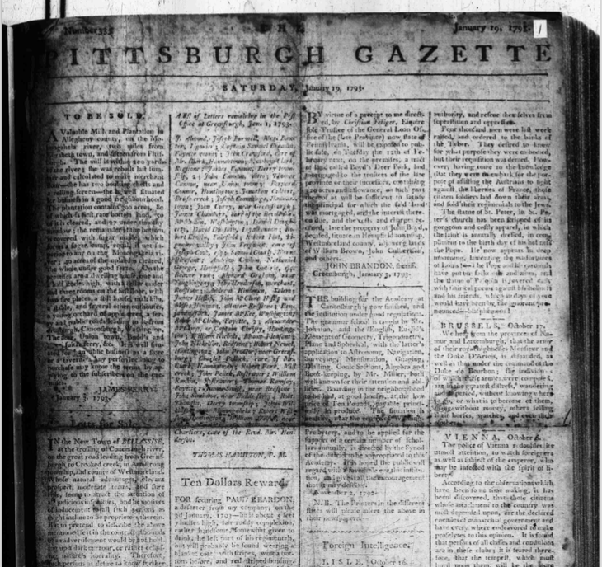
Low Quality, Simple Layout
(1783) shadow, folds

Slide 10
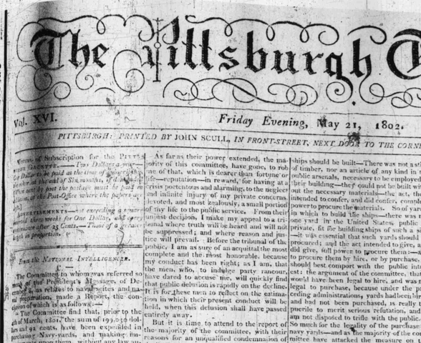
Low Quality, Simple Layout
(1802) noise, curvature

Slide 11
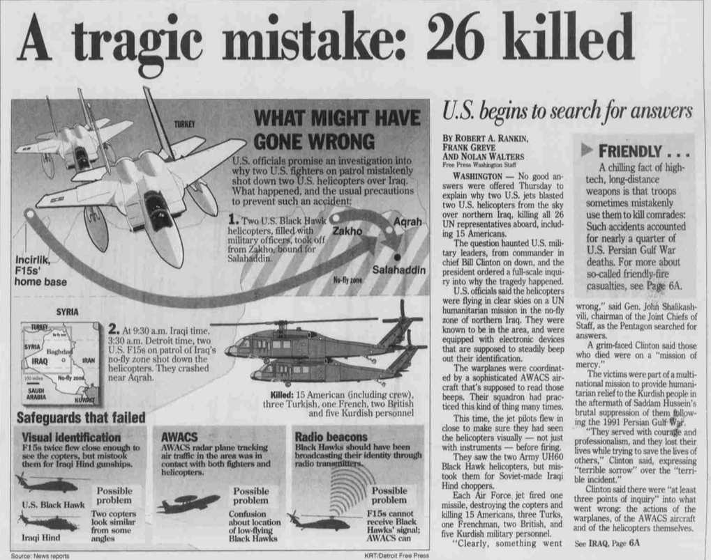
High Quality, Complex Layout

Slide 12
High Quality, Complex Layout

Slide 13
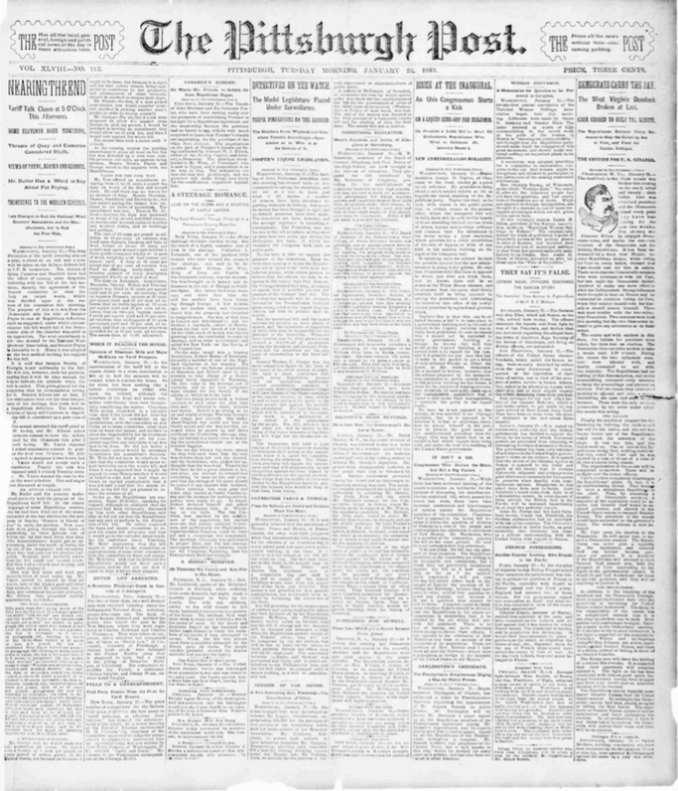
High Quality, Simple Layout

Slide 14
Conclusions
Most promising Class:
Old newspapers (e.g. 1800’s Pittsburgh Post)
Layout: Columns internally divided into rows
Images Rare. High density.
Complexities to consider:
Nesting of text entities (what is an article?)
Matching titles to articles
Non-text (ads, figures, whitespace, ornaments)
Physical damage: warp, crease, fold, rip
Scan quality: noise, lighting, scratches, warp

Slide 15
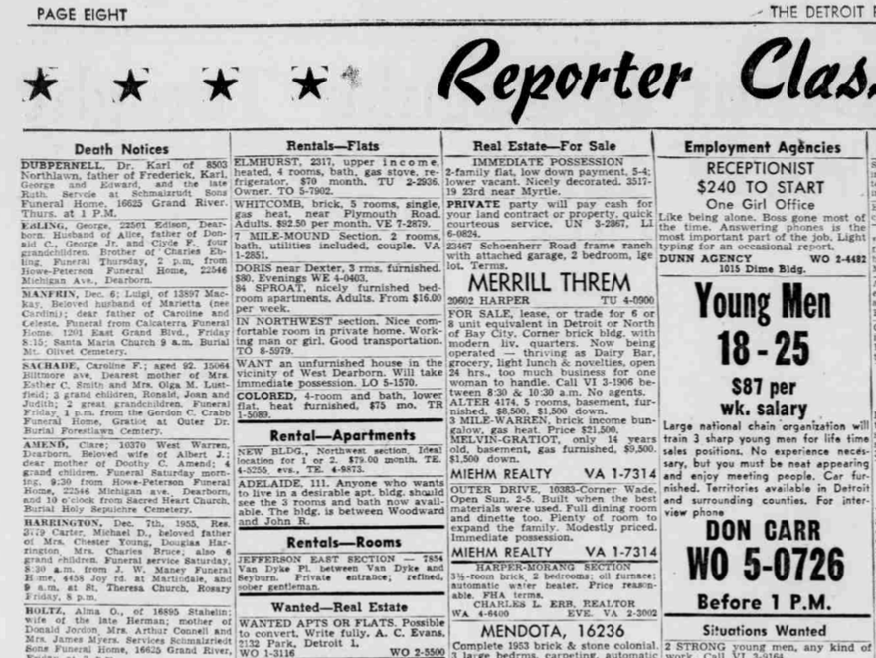
Article Levels

Slide 16
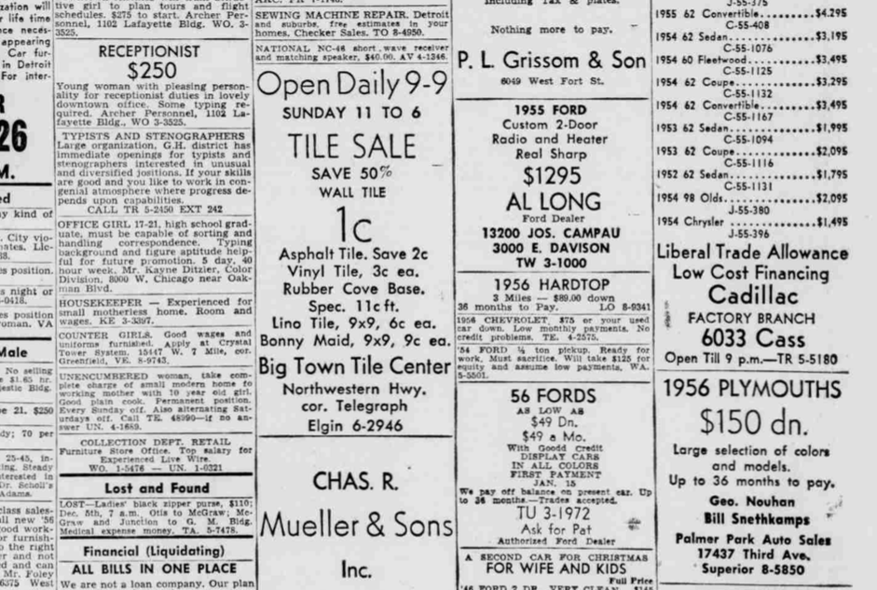
Article Levels
classifieds

Slide 17
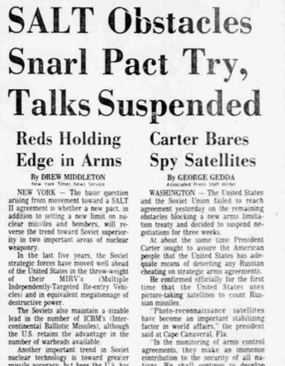
Matching titles to articles
To which article do we assign the main title?

Slide 18
Matching titles to articles
To which article do we assign the main title?
...text clustering?
[even on 1 page]

Slide 19
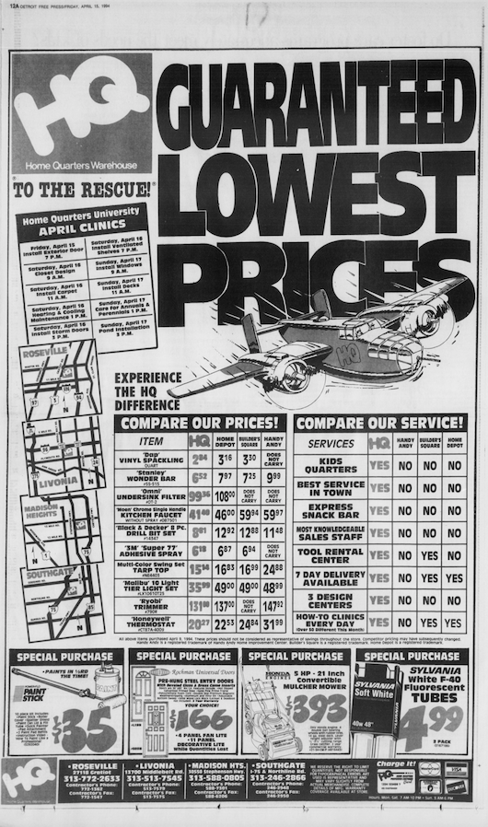
Advertisements
Full-page advertisement

Slide 20
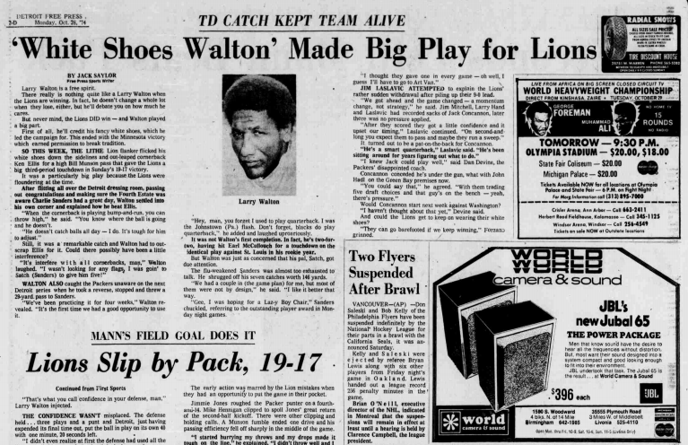
Advertisements

Slide 21
Segmentations
What is a Segmentation?
Entities usually rectangles aligned w/axes--“boxes”
Non-text entities: boxes needn’t cover.
Finite set of disjoint boxes.
“Article Levels” suggests: nested (tree)?

Slide 22
Evaluating Segmentations
How similar is given seg to ground truth?
Asymmetry: better too large than too small

Slide 23
Evaluating Segmentations
How similar is given seg to ground truth?
Asymmetry: better too large than too small
For computer search, ultimately care about bag-of-words structure.
How often does seg agree with truth as to whether two words are in same bag?

Slide 24
Evaluating Segmentations
How similar is given seg to ground truth?
Asymmetry: better too large than too small
For computer search, ultimately care about bag-of-words structure.
How often does seg agree with truth as to whether two pixels are in same box?

Slide 25
Evaluating Segmentations
Box-of-pixels metrics.
Integrate over all pairs of points
Variant: points from union(seg, truth). (asym!)
Or, guess correspondence between entities in segmentation and truth
Problems if number of entities differ
Proposed solution [Gatos 2001, Phillips 1999]
Find many-to-1 and 1-to-many matches.

Slide 26
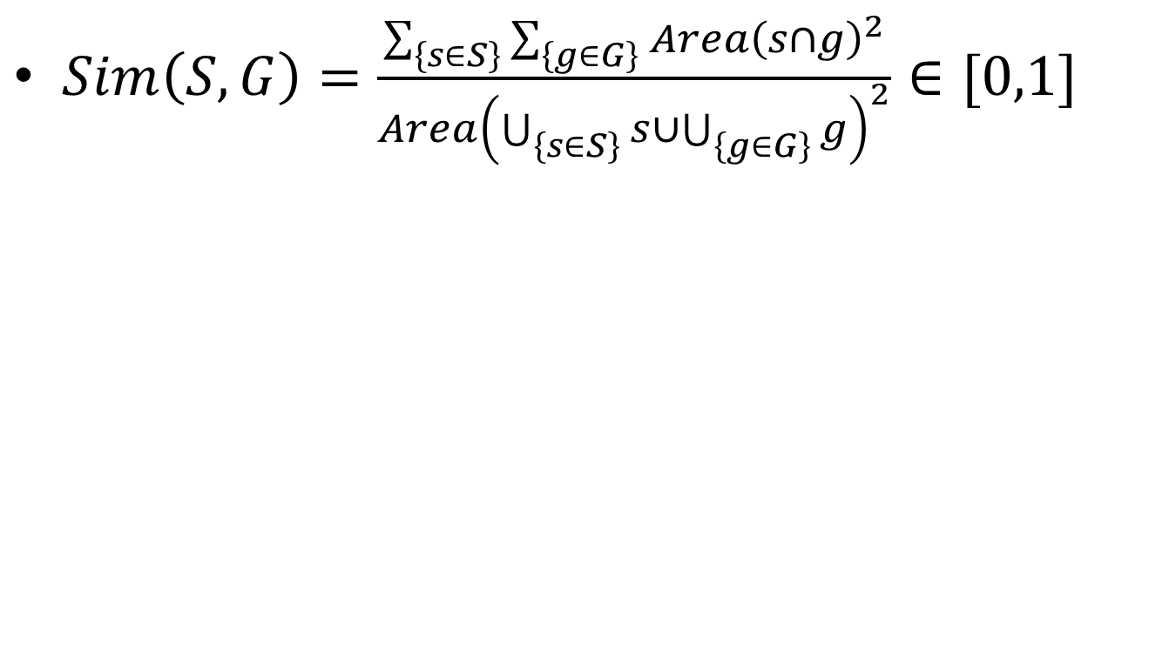
Example: Bag-of-pixels
$Sim\left(S,G\right)=\frac{\sum_{\left\{s∈S\right\}}{\sum_{\left\{g∈G\right\}}{Area{\left(s∩g\right)}^{2}}}}{Area{\left(\bigcup_{\left\{s∈S\right\}}{s}∪\bigcup_{\left\{g∈G\right\}}{g}\right)}^{2}}∈[0,1]$

Slide 27
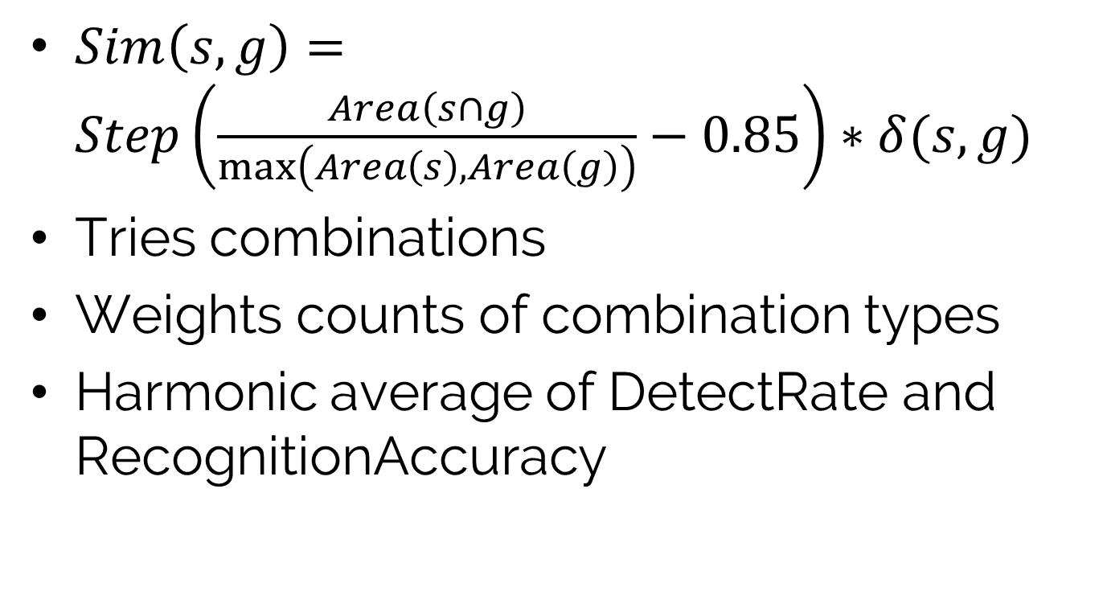
Example: Gatos
$Sim\left(s,g\right)=Step\left(\frac{Area\left(s∩g\right)}{\max\left(Area\left(s\right), Area\left(g\right)\right)}−0.85\right)∗δ(s,g)$
Tries combinations
Weights counts of combination types
Harmonic average of DetectRate and RecognitionAccuracy

Slide 28
Summary

